Slide 1

Department of Computer Science, MNIT
Topic: Rivest Cipher 4
Submitted By:
Akshita Sharma
Dharmanshu Sharma
Anjali Priya
Abhinandan Singhal
Divya Jyoti
Submitted To:
Dr. Meenakshi Tripathi

Slide 2
Contents
Stream Cipher
Introduction to RC4
RC4 algorithm
Example
Advantages
Weakness of RC4
Applications
Conclusion

Slide 3
Stream Cipher
A stream cipher is an encryption technique that works byte by byte to transform plain text into code that's unreadable to anyone without the proper key.
In this cipher a key is input to a pseudorandom bit generator that produces a stream of 8 bit numbers.
The output of the generator is generated by using the bitwise exclusive-OR(XOR) operation.

Slide 4
Introduction to RC4(Rivest Cipher 4)
RC4 was created in 1987 by Ron Rivest, a cryptographer at MIT, as a trade secret algorithm for RSA Security.
It is a symmetric key stream cipher algorithm.
It is a variable key-size stream cipher with byte-oriented operations.
The algorithm is based on the use of a random permutation.

Slide 5
RC4 Algorithm
It uses an array- state vector(S) of length 256 with elements S[0], S[1],..., S[255].
It has a key array of length 256 (0 - 255).
The algorithm has 4 steps-
1) Initialization of state vector S
2) Key Scheduling
3) Key Stream Generation
4) Encryption and Decryption

Slide 6
1) Initialization of S
The entries of S are set equal to the values from 0 through 255, that is S[0] = 0, S[1] = 1……., S[255] = 255.
A temporary vector, T is also created.
If the length of the key K is 256 bytes, then K is transferred to T.
Otherwise, elements of T are copied from K, and then K is repeated as many times as necessary to fill out T.
/* Initialization of S*/
for i=0 to 255 do
S[i] = i;
T[i] = K[i mod keylen] // keylen is length of K array

Slide 7
2) Key Scheduling
We use T to produce initial permutation of S.
Here number of iterations = size of S array
Algorithm:
/* Initial Permutation of S */
j=0;
for i = 0 to 255 do
j = (j + S[i] + T[i]) mod 256;
Swap(S[i], S[j]);

Slide 8
3)Key Stream Generation
Number of iterations = Size of key array
Stream generation involves cycling through all the elements of S[i], and for each S[i], swapping S[i] with another byte in S.
After S[255] is reached, the process continues starting over again at S[0].

Slide 9
/* Stream Generation*/
I, j = 0;
While (true)
i= (i+1)mod 256;
j =(j+S[i])mod 256;
swap(S[i], S[j]);
t = (S[i] +S[j])mod 256
k = S[t];

Slide 10
4) Encryption and Decryption
To encrypt, XOR the value of K with the next byte of the plain text.
To decrypt, XOR the value K with the next byte of the cipher text.

Slide 11
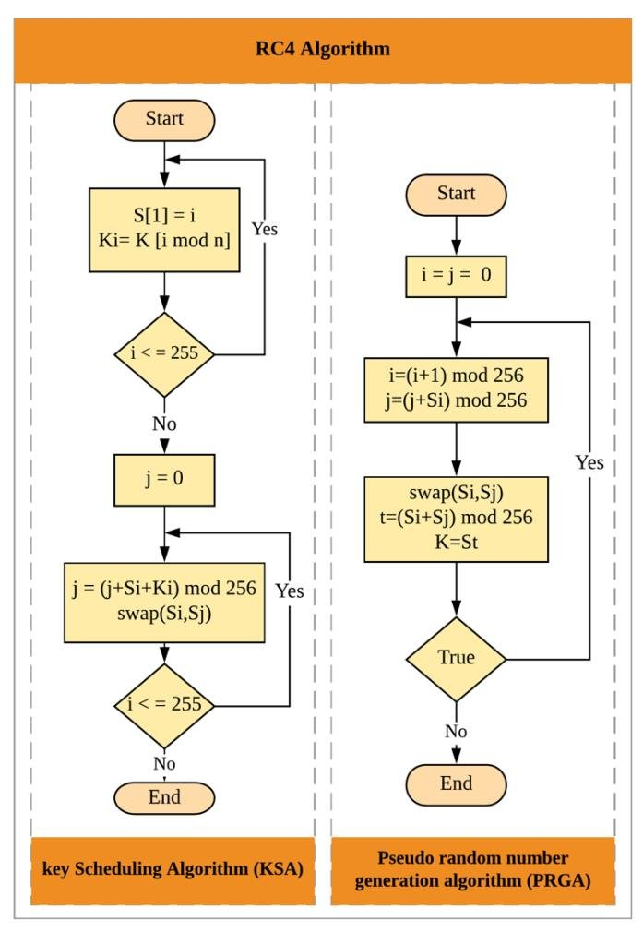

Slide 12
Example
Given, Key-array= [1,2,3,6]
Plain text= [1,2,2,2]
Step 1: Initialization of S- vector
S- array = [0,1,2,3,4,5,6,7]
Initialization of T-array with key
T = [1,2,3,6,1,2,3,6]
Step 2: Key Scheduling
Iteration 1: j=0, i=0
j= [0+0+1] mod 8 // j= [j+ S[i] + T[i]] here, S[0] = 0, T[0] = 1
j =1
swap(S[0], S[1])
Now , new State Vector = [1,0,2,3,4,5,6,7]

Slide 13
Iteration 2: i=1
j= [1+0+2] mod 8 // j= [j+ S[i] + T[i]] here, S[1] = 0, T[1] = 2
j = 3
swap(S[1], S[3])
Now , new State Vector = [1,3,2,0,4,5,6,7] and so on…..
Now Final State Vector –S after 8 iterations is: [1,3,7,4,6,0,2,5]

Slide 14
Step 3: Stream Generation
i = 0, j= 0
Iteration 1: i= [0+1] mod 8
j = [ 0 + 3] mod 8 // S[1] = 3 here j=[j+S[i]]mod 8
swap(S[1], S[3])
t = (3 + 4) mod 8 = 7 // t = (S[i] +S[j])mod 8
k = S[7] =5 // here, the output of first iteration is 5
New state Vector = [1,4,7,3,6,0,2,5]

Slide 15
Iteration 2: i= [1+1] mod 8 = 2
j = [ 3+7] mod 8 // S[2] = 7
swap(S[2], S[2])
t = (2 + 2) mod 8 = 4
k = S[4] =6 // here, the output of second iteration is 6
New state Vector = [1,4,7,3,6,0,2,5] , and so on…..
After 4 iterations, the key is : [5,6,0,2]

Slide 16
Step 4: Encryption
Plain text = [1,2,2,2]
New Key array = [5,6,0,2]
Now it will be converted into binary So,
Plain Text = [001 010 010 010]
New Key array = [101 110 000 010]
Cipher Text = (Plain text) XOR (New Key Array)
= [ 100 100 010 000]

Slide 17
Decryption
Cipher Text = [4,4,2,0]
New Key array = [5,6,0,2]
Now it will be converted into binary So,
Cipher Text = [100 100 010 000]
New Key array = [101 110 000 010]
Plain Text = (Cipher text) XOR (New Key Array)
= [ 001 010 010 010]

Slide 18
Advantage of RC4
Simple to implement and speed of operation and deployment.
It allows working with massive data stream in an efficient and fast way.
Rc4 stream cipher are light in terms of memory use.

Slide 19
Weakness of RC4
Weak key: Small set of key in RC4 leaves some traces in keystream generated after KSA or in the output bytes after PRGA. If such trace are followed by attacker than he can able to recover key.
Key collision : In KSA it may be possible to generate a similar state even if two different keys are used and a similar output key stream will be produce.
Bias in the first few bytes: The initial output bytes of the key stream exhibit biases that can be exploited by the attacker.
State Recovery : The state space size in RC4 is N!*N^2 where N! is the space of N bytes in the internal state S and N^2 comes from all possible combination of i and j. Hence in RC4 for N=256 the total state space is 256!*256^2 is approx. 2^1700. Inspite of big state space state recovery is possible.

Slide 20
Application
Secure sockets layer (SSL) : RC4 was extensively used for SSL protocol, which was primarily used for secure transaction.
Wired equivalent privacy(WEP) : RC4 was used for key streaming for wireless networks to provide privacy. It was later replaced because of its known vulnerabilities.
Transport layer Security (TSL) :RC4 was used for the TSL protocol, mainly used for securing communication over the internet.

Slide 21
Conclusion
It is found that simple and robust structure of RC4 is still attracting community by improving security of the cipher.
It is extensively deployed in wireless network and internet protocol .
Although many improved variants of RC4 which removes the existing weaknesses and enhance the security of the cipher there are still many open research challenges and issue related to search for more biases , Key collision in key stream and key recovery attack .
Therefore there is many scope to further investigate the issues in RC4 particularly the random behaviour of bytes in the state permutation and develop more efficient and effective RC4 encryption Algorithm.

Slide 22
References
https://www.researchgate.net/publication/283005916_A_Survey_on_RC4_Stream_Cipher
Cryptography and Network Security by William Stallings

Slide 23
THANK YOU

